Slide 1


Ayiti Analytics Data Processing Bootcamp
Due Friday, June 23th at 1:00pm

Slide 2
Problem
❏ The business problem
❏ The stakeholders impacted by the problem
In an effort to attract and integrate more professionals in the field of data science, Ayiti Analytics decided to expand its program to more municipalities. For the 2021, they have received applications from all over the country. Based on this data, they want to organize the program in other communes, but which ones?
The Ayiti Analytics team
The interested applicants
The society

Slide 3

Problem
❏ The importance of the problem for the organization
Ayiti Analytics wants to expand its network in the whole country. He believes that the data science method to solve the problems of our communities could be very effective. That's why they want to have as many people as possible but especially in different communities. In this state of affairs, they will be able to diversify their projects and all of their activities in different places in the country.

Slide 4
Methodology
The methods and data sources used for the analysis
The data was collected on the website of Ayiti Analytics from the people who filled in the form and enrolled in the introductory courses. We had seven datasets to extract the data that could help solve the problem the best way.
Python is used through its different libraries to clean, do exploratory data analysis and perform inferential statistics.

Slide 5
Univariate Analysis
Profile of applicants
Sex
Sex | Count | Frequency in %
Male | 203 | 81
Female | 47 | 19
Men are overrepresented, there are 4 times more men than women who apply. Inequality between men and women in technological fields in Haiti explains this trend.

Slide 6
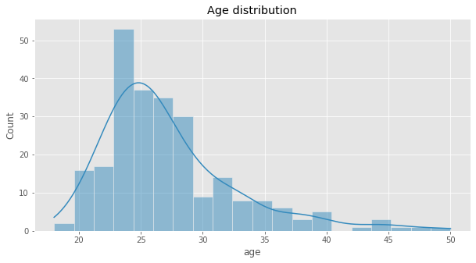
Univariate Analysis
Age distribution
Most of the applicants are under 30 years old, we can say in particular that those aged from 22 to 28 years are very represented and are very interested in data science.

Slide 7
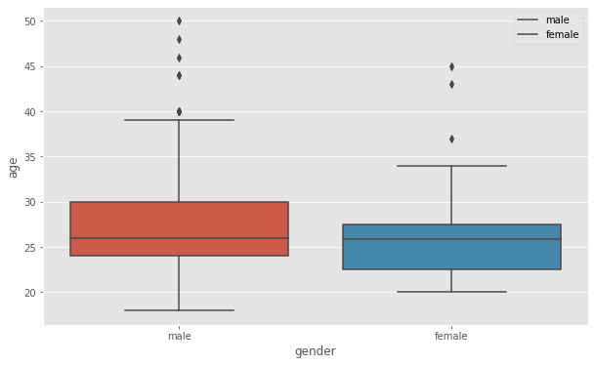
Univariate Analysis
Age distribution
The age distribution of men and women does not differ greatly. The The median is almost identical and would be around 28 years.

Slide 8
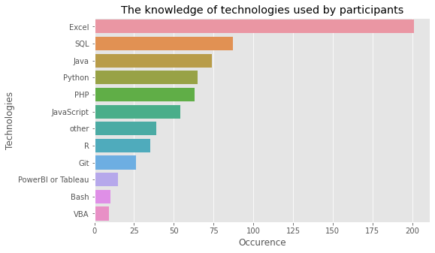
Univariate Analysis
Technologic tools by applicants
Excel is the most used tool among the applicants.

Slide 9
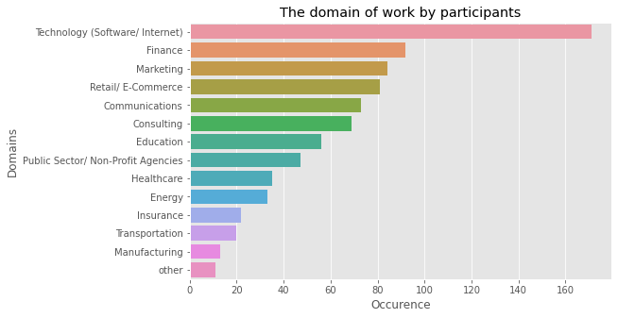
Univariate Analysis
Domains of work by applicants
Technology(software/internet) and finance seem to be the domains of work most found among the applicants.

Slide 10
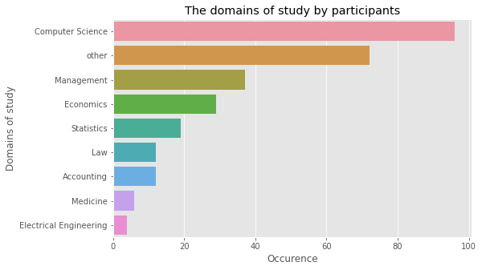
Univariate Analysis
Domains of study by applicants
Computer science are the domain of study better represented. We know how much diversity is important for AA.

Slide 11
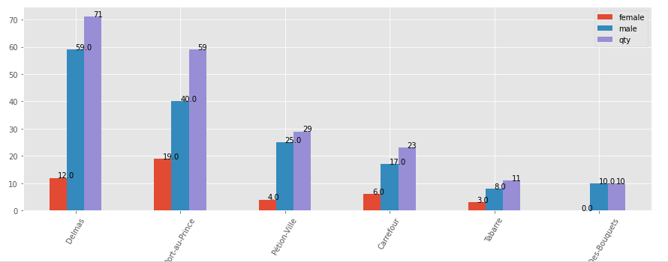
Bivariate Analysis
Sex distribution among communes

Slide 12
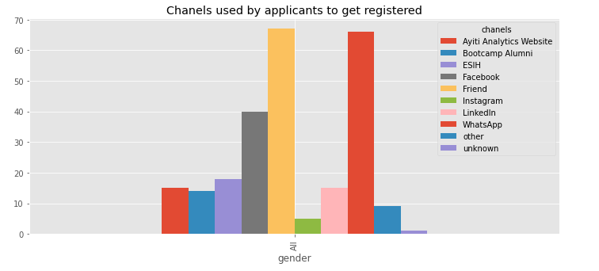
Bivariate Analysis
Registrations evolution by week
The best chanels to use to attract applicants are Friends and Whatsapp, we can say that way of the way to get more is to use networking. This does not mean that the best channel for all applicants is the same for each gender independently. We know how much AA want to reduce the inequality between men and women in Data Science Domain.

Slide 13
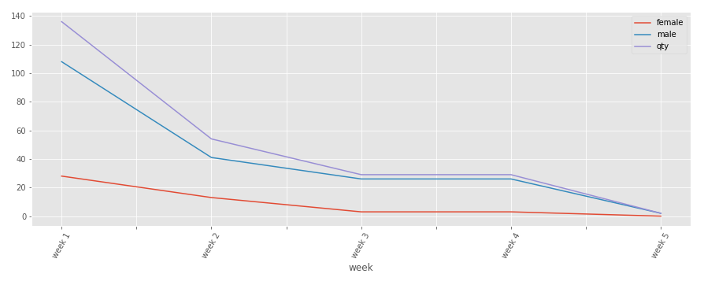
Bivariate Analysis
Registrations evolution by week
We can see from this graph that increasing the number of days will not increase the number of registrations, the best strategy would be to use the most used channels to attract the most applicants.

Slide 14
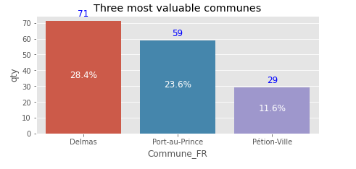
Results
Three municipalities with 30 students
We could consider them beacause we suppose that no bootcamp have been already done anywhere.
The number of applicants per municipality remains the most important criterion since the municipality must have at least 30 people. However, we could take an applicant from a neighboring commune.

Slide 15
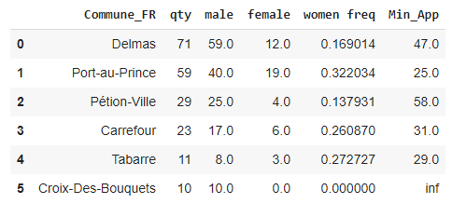
Results
The minimum number of applicants required to ensure that there are at least 8 women
Based on the frequency of women for each municipality, we calculate the number of people who must register at least for us to have

Slide 16
Discussion & Proposed Solution
Communicate your proposed solution to your audience. Based on your results, how might you propose solving the business problem?
❏ What is your proposed solution?
❏ What are strengths of the organization that you have leveraged in your solution?
❏ What are weaknesses of the organization that could undermine your solution?
❏ What are challenges that you might encounter? How can you mitigate them?

Slide 17
References & Appendices
Provide citations for your work and provide resources for your audience to learn more about the technical aspects of your project. Share links to your GitHub repository or links accompanying spreadsheets.

Slide 18
Present Team Members
Team Member 1
Team Member 2
Team Member 3

